Slide 1

12

Slide 2
Artificial Intelligence @ COMSATS IIT LHR
Representation (State Space Modeling), Searching and Planning
Wajahat M. Qazi, Ph.D.
Assistant Professor| DDP Coordinator,
In-charge Intelligent Machines and Robotics|
Department of Computer Science,
COMSATS Institute of Information Technology Lahore

Slide 3
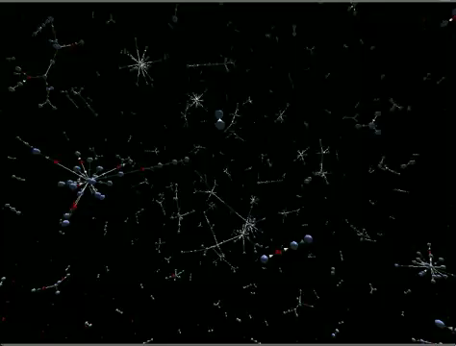
Artificial Intelligence @ COMSATS IIT LHR
Representation (State Space Modeling), Searching and Planning
Wajahat M. Qazi, Ph.D.
Assistant Professor| DDP Coordinator,
In-charge Intelligent Machines and Robotics|
Department of Computer Science,
COMSATS Institute of Information Technology Lahore

Slide 4
How?
Graph based Representation

Slide 5
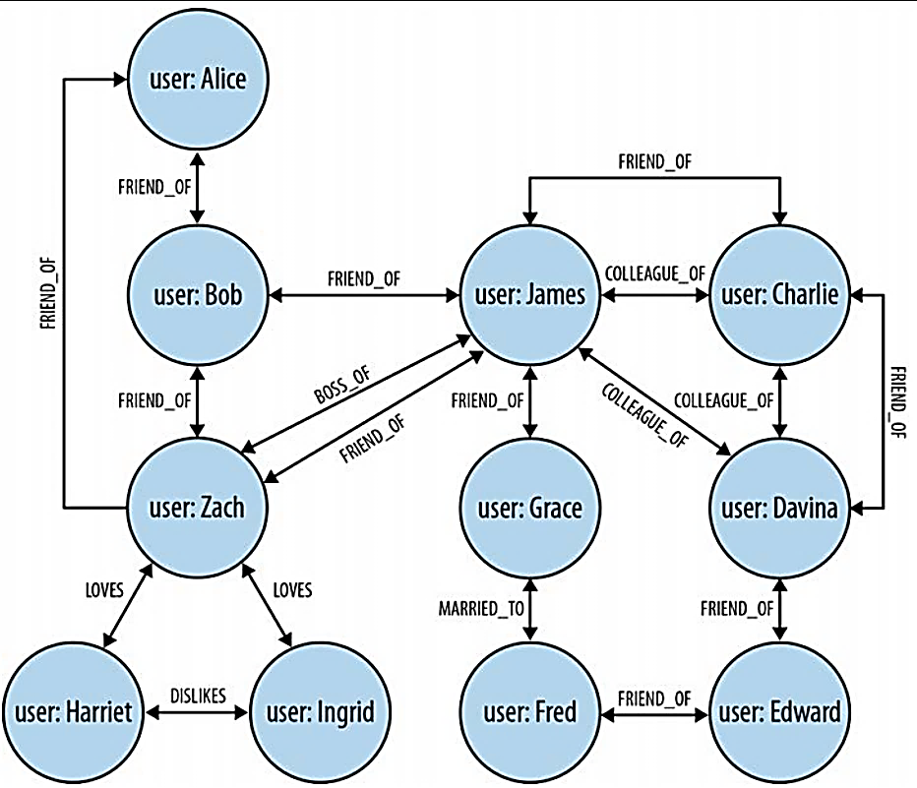
Graph Representation

Slide 6
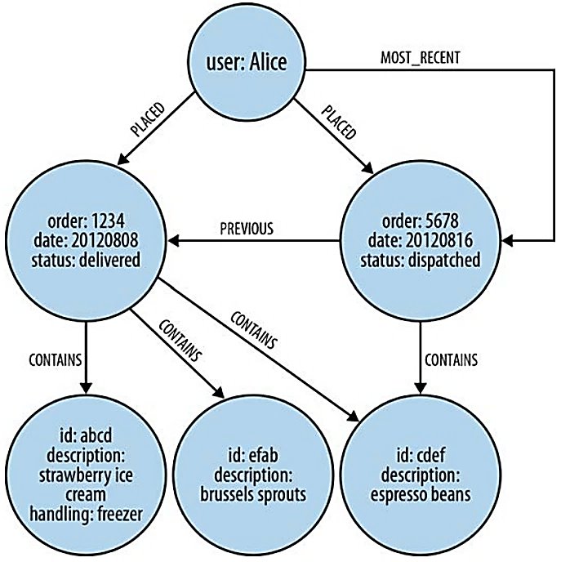
Graph Representation

Slide 7
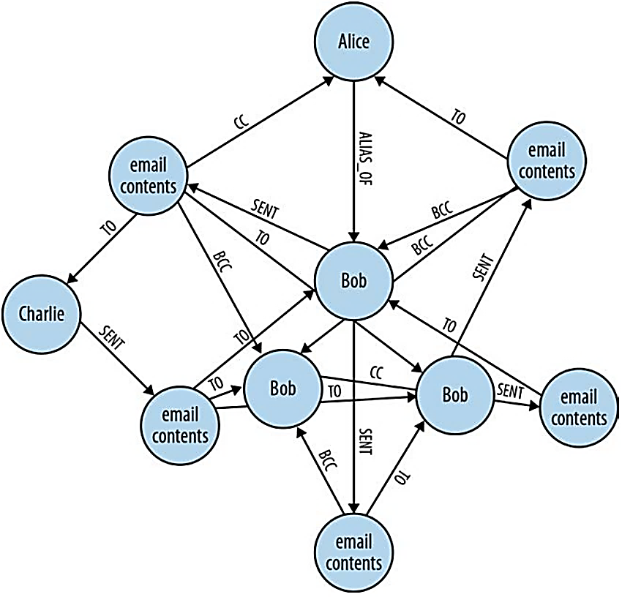
Graph Representation

Slide 8
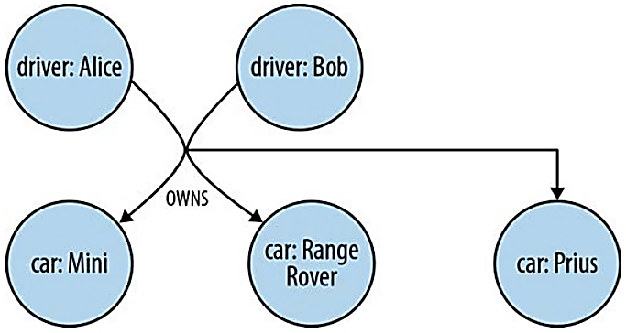
Hypergraph Representation

Slide 9
Neo4j: A Graph Database

Slide 10
State Space Modeling

Slide 11
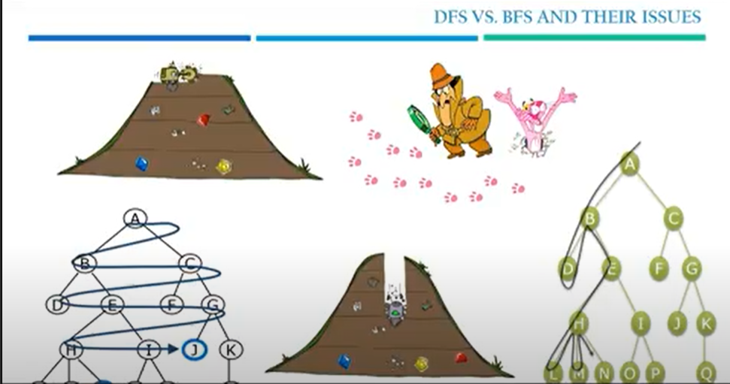

Slide 12
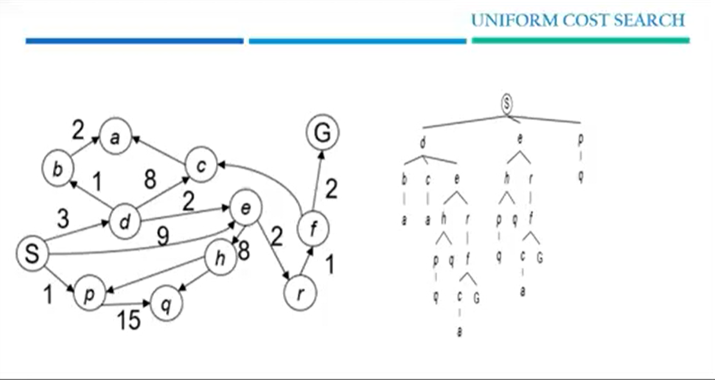

Slide 13
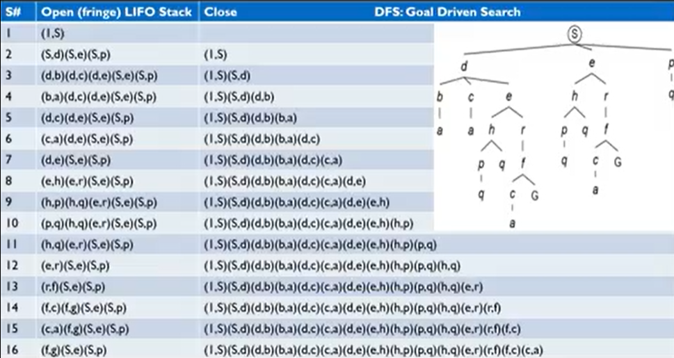

Slide 14
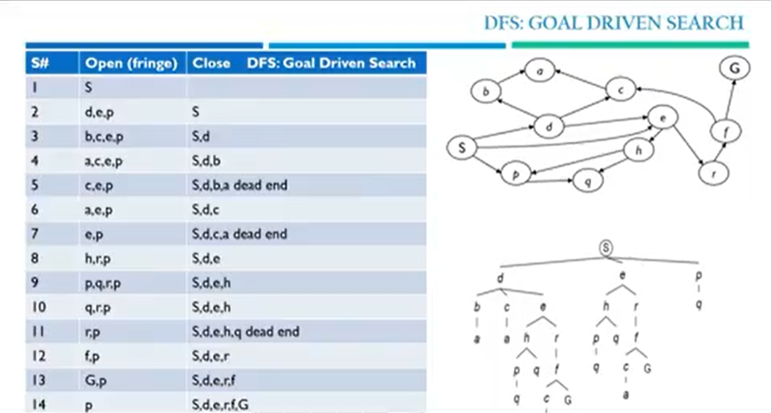

Slide 15
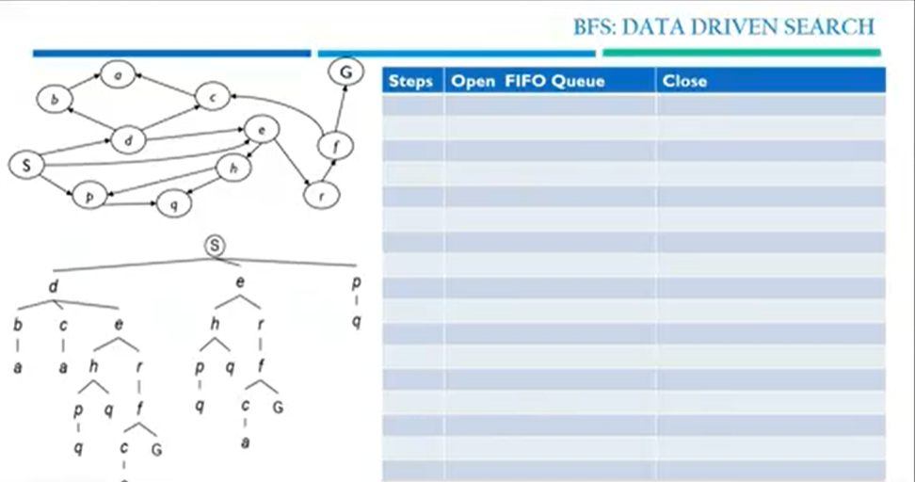

Slide 16
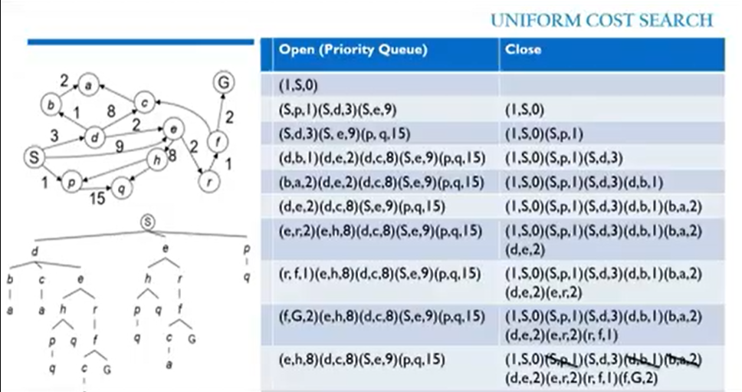

Slide 17

Tree search:
A* is optimal if heuristic is admissible
UCS is a special case (h = 0)
Graph search:
A* optimal if heuristic is consistent
UCS optimal (h = 0 is consistent)
Consistency implies admissibility
In general, most natural admissible heuristics tend to be consistent, especially if from relaxed problems

Slide 18
Simplify the Assumptions
Environment is static
no changes in environment while problem is being solved
Environment is observable
Environment and actions are discrete
(typically assumed, but exceptions are always there)
Environment is deterministic

Slide 19
Formulate a State Space (Navigation Example)
Set of States
Individual cities
Operators
Freeway routes from one city to another
Start State
Current City
Goal States
Set of cities we would like to be in
Solution
A specific goal city,
A sequence of operators which get us there,

Slide 20
Perform Abstraction
Removing irrelevant details to create an abstract representation: ``high-level” view
Navigation Example: how do we define states and operators?
First step is to abstract “the big picture”
Solve a map problem
nodes = cities, links = freeways/roads (a high-level description)
This description is an abstraction of the real problem
Can later worry about details like Refueling Stations, Scene Views, Refreshment Points…
Abstraction is critical for automated problem solving
must create an approximate, simplified, model of the world for the computer to deal with: real-world is too detailed to model exactly
good abstractions retain all important details

Slide 21
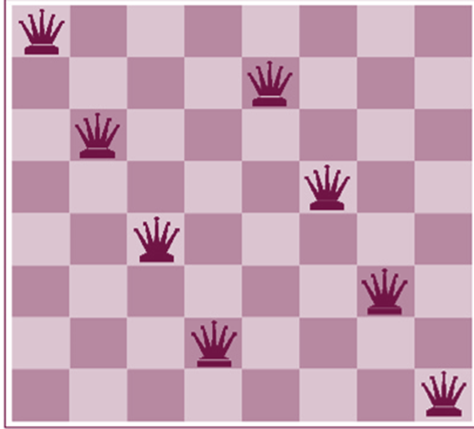
Formulate a State Space (8 Queen Example)
States:
any arrangement of n<=8 queens
or arrangements of n<=8 queens in leftmost n
columns, 1 per column, such that no queen
attacks any other.
initial state:
no queens on the board
Actions:
add queen to any empty square
or add queen to leftmost empty square such that it is not attacked by other queens.
Goal Test:
8 queens on the board, none attacked.
Path Cost? 1 per move

Slide 22
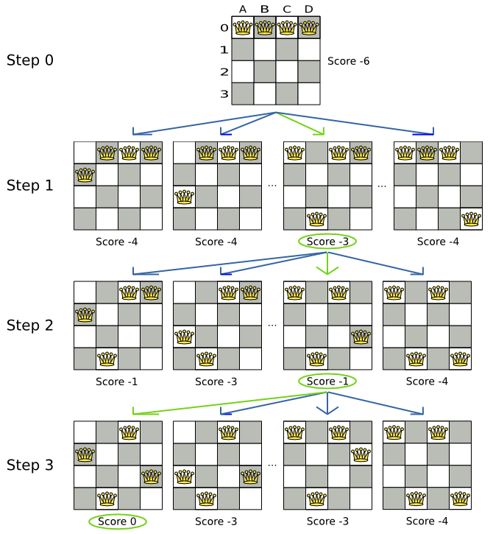

Slide 23
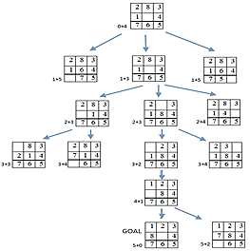
8- Puzzle Example for A* = UCS + Greedy: F(n) = H(n) + G(n)

Slide 24
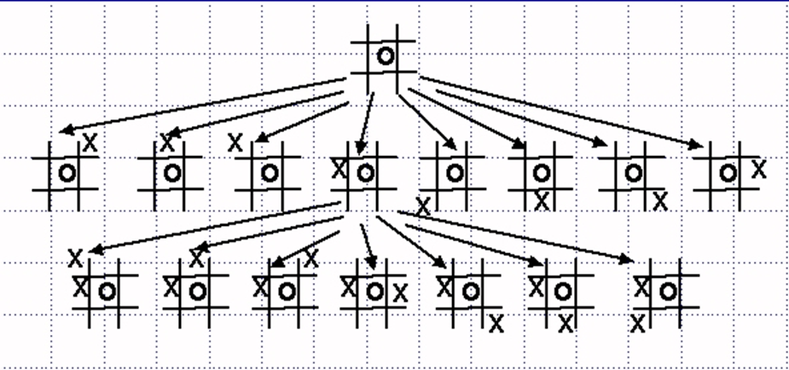
Searching Strategies
A search strategy is defined by picking the order of node expansion
Strategies are evaluated along the following dimensions:
Completeness: does it always find a solution if one exists?
Time complexity: number of nodes generated
Space complexity: maximum number of nodes in memory
Optimality: does it always find a least-cost solution?
Time and space complexity are measured in terms of
b: maximum branching factor of the search tree
d: depth of the least-cost solution
m: maximum depth of the state space (may be ∞)

Slide 25
Search Strategy and Complexity Example
Depth of Solution | Node to Expand | Time | Memory
0 | 1 | 1 millisecond | 100 bytes
2 | 11 | 0.1 Second | 11 Kbytes
4 | 11,111 | 11 Second | 1 Megabyte
8 | 10⁸ | 31 hours | 11 Gigabytes
12 | 10¹² | 35 Years | 111 Terabytes
Assuming b=10, 1000 nodes/sec, 100 bytes/node

Slide 26
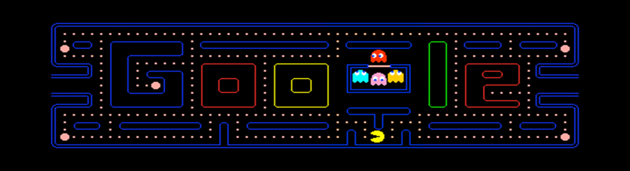
How?

Slide 27
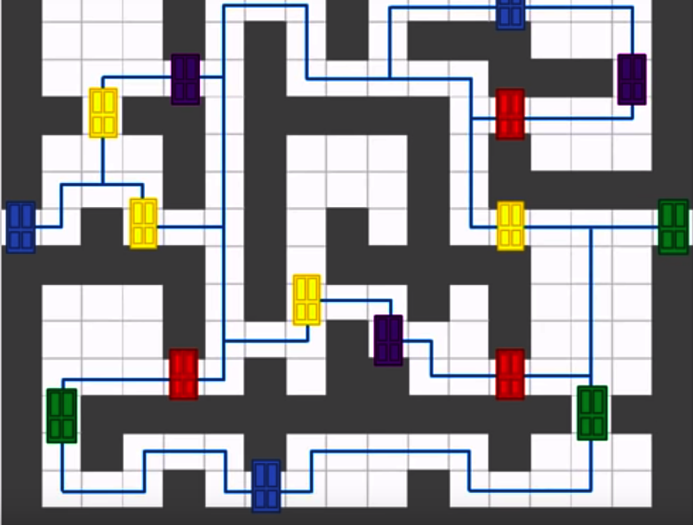
Grid based?

Slide 28
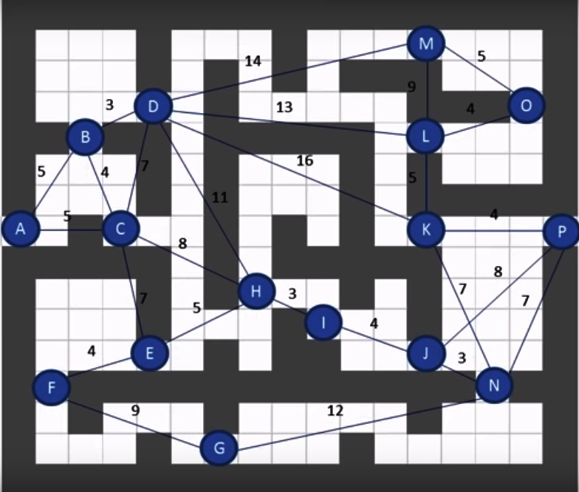
Grid based?

Slide 29
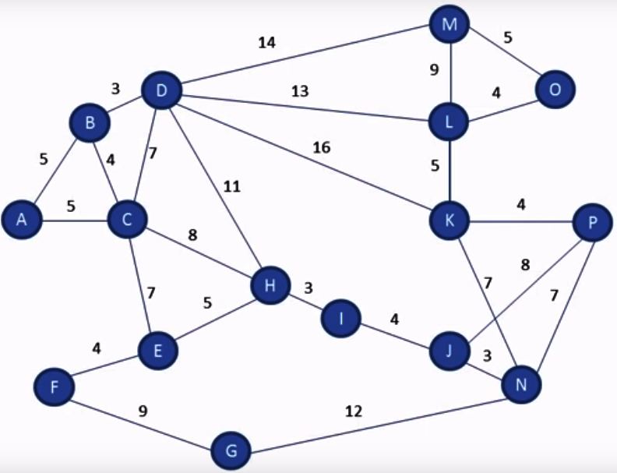
Grid based?

Slide 30
Agents and Problem Solving (How They Do IT?)

Slide 31
Lets see how it works

Slide 32

State-space Search and Planning

Slide 33
Searching and Planning (Part I)
State Space and Search
DFS and Goal Driven Search
BFS and Data Driven Search
Uniform-cost Search (UCS)
Greedy Algorithm
A*

Slide 34
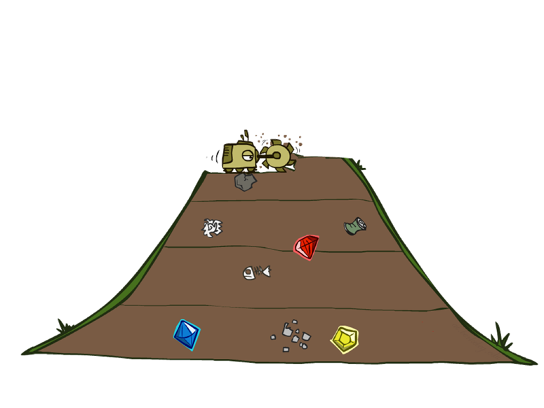


DFS vs. BFS and Their Issues

Slide 35
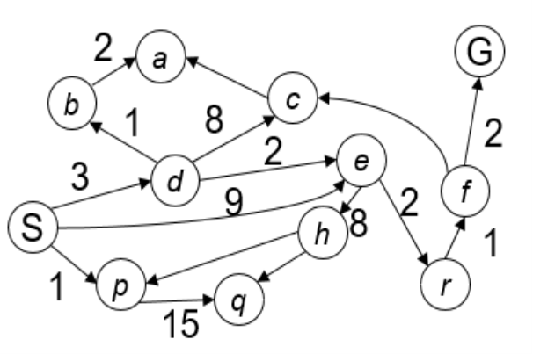
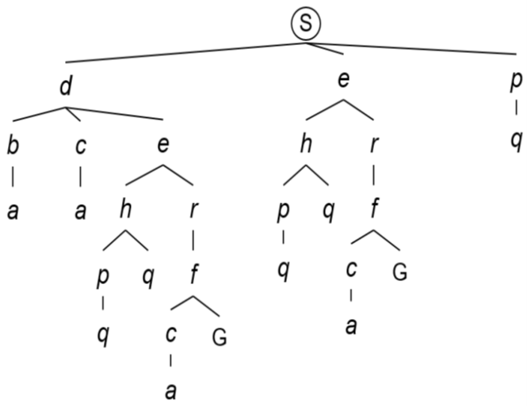
Uniform Cost Search

Slide 36
Heuristics and Search, h(x)
Generally considered to be Rule of Thumb but in AI it’s a function
Method of Discovering
A function that estimates how close a state is to a goal
Designed for a particular search problem
Its about your cleverness
Examples: Manhattan distance, Euclidean distance for path

Slide 37

Our Version of the Story

Slide 38


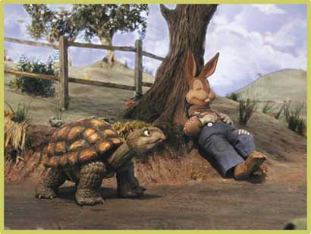




General Tree Search

Slide 39
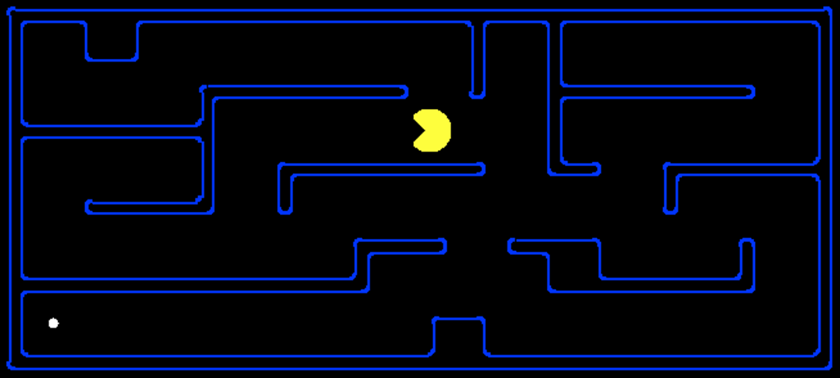
PACMAN and Heuristics

Slide 40
What Might Go Wrong with Greedy Search

Slide 41
Heuristics?

Slide 42
Heuristics?

Slide 43
Heuristics?

Slide 44
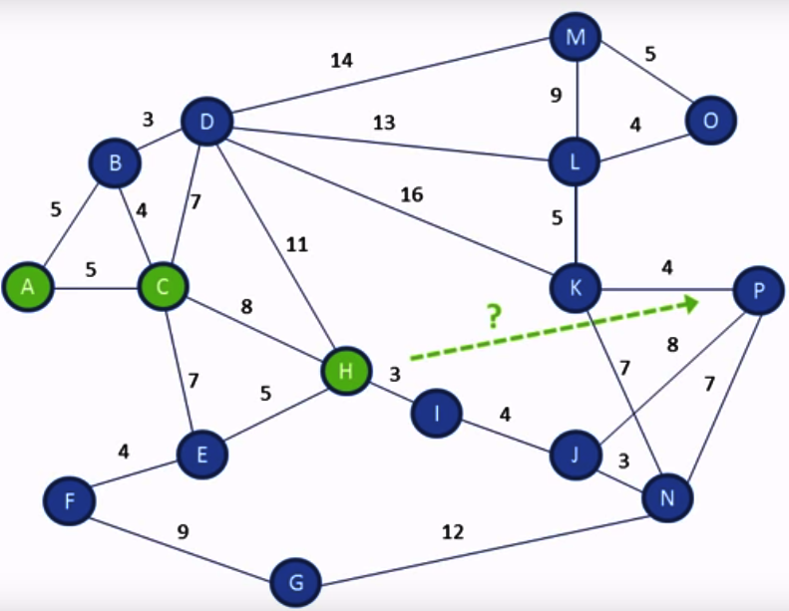
Heuristics?

Slide 45
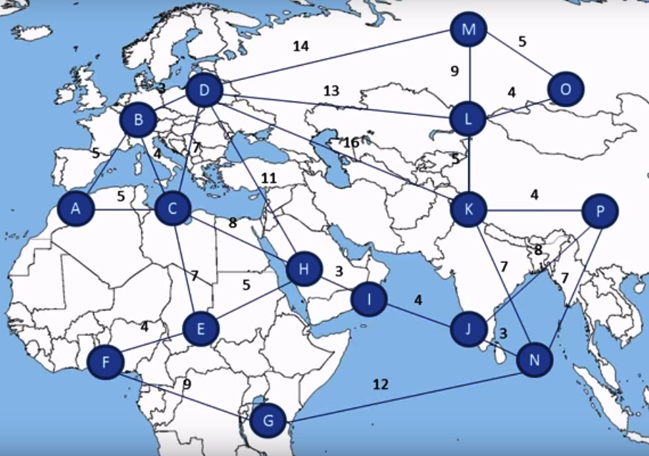
Heuristics?

Slide 46
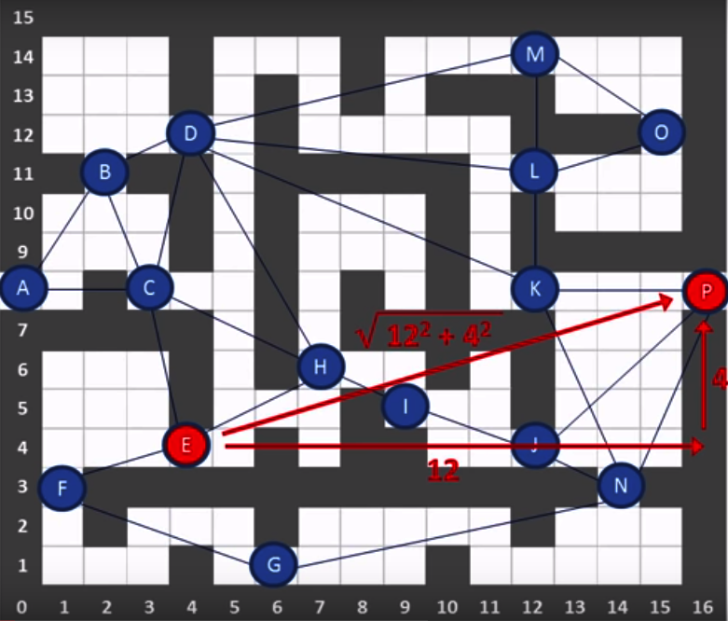
Heuristics? Euclidian Distance

Slide 47
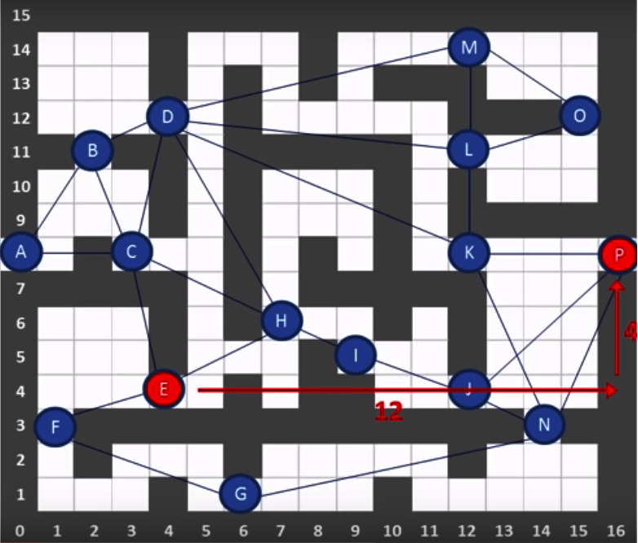
Heuristics? Manhattan Distance

Slide 48

Greedy Search

Slide 49
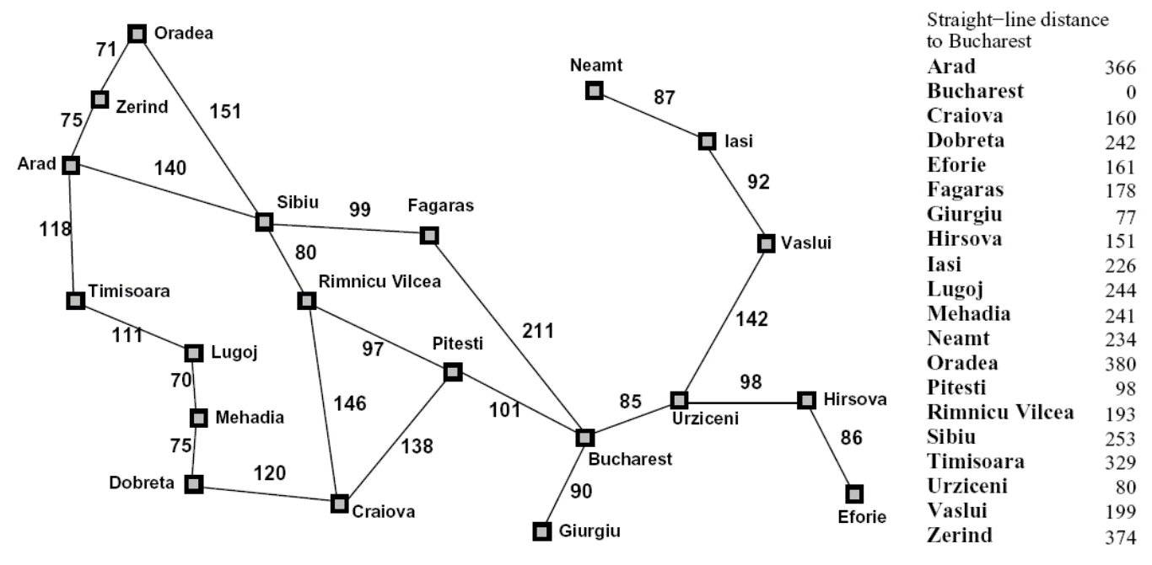
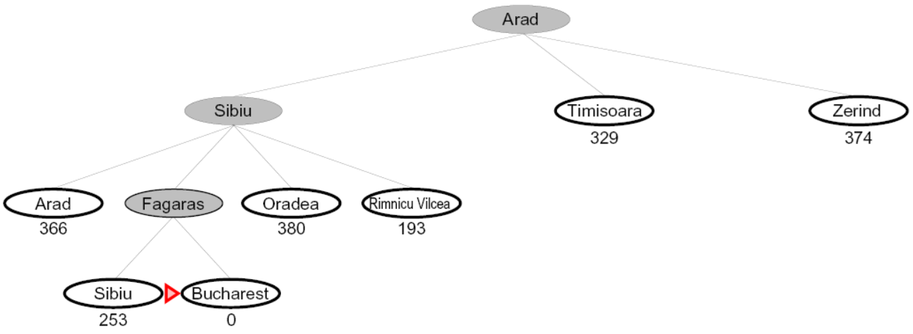
Greedy Search and Path Finding

Slide 50
A* (A-Star Algorithm)
UCS+ Greedy

Slide 51

Our Version of the Story

Slide 52
A* = UCS + Greedy: F(n) = H(n) + G(n)

Slide 53
Is A* Optimal? What Might Go Wrong with A*

Slide 54

Admissible Heuristics
Admissible if it never overestimates the cost of reaching the goal
The cost it estimates to reach the goal is not higher than the lowest possible cost from the current point in the path

Slide 55
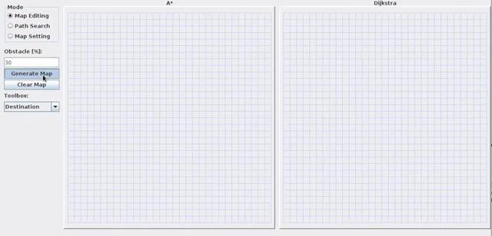
Comparison

Slide 56
JAZAK ALLAH

